Slide 1
NAME : NANDHINI. J REG.NO :311521104029 DEPT :CSE COLLEGE :MEENAKSHI SUNDARARAJAN ENGINEERING COLLEGE NAAN MUDHALVAN ID: au311521104029 GMAIL ID: nandhinijx@gmail.com
WEATHER FORECAST PREDICTION USING ANN AND RNN
3/21/2024 Annual Review

Slide 2
PROJECT TITLE
WEATHER FORECAST PREDICTION USING ANN AND RNN
3/21/2024 Annual Review

Slide 3


AGENDA
Problem statement
Proposed solution
System development approach
Project overview
Algorithm and deployment
Solution and value proposition
Result
Conclusion
References
3/21/2024 Annual Review

Slide 4

PROBLEM STATEMENT
The project aims to forecast weather temperatures for Kanpur using Artificial Neural Networks (ANN) and Recurrent Neural Networks (RNN). Leveraging historical weather data from the Kanpur dataset, the models are trained to predict future maximum temperatures. The dataset includes features such as maximum temperature, minimum temperature, humidity, and other weather variables. After training the models, predictions are made for future temperatures, which are then visualized using histograms alongside the actual temperatures. The goal is to develop accurate temperature forecasting models to aid in weather prediction and planning for the Kanpur region.
3/21/2024 Annual Review

Slide 5
PROPOSED SOLUTION
The proposed solution for this weather forecasting project involves leveraging both Artificial Neural Networks (ANN) and Recurrent Neural Networks (RNN), specifically Long Short-Term Memory (LSTM) networks.
The project utilizes historical weather data from the Kanpur dataset, including features such as maximum temperature, minimum temperature, humidity, and other relevant weather variables.
Data is preprocessed and split into training and testing sets. ANN and LSTM models are then constructed and trained on the training data to predict future maximum temperatures.
The performance of the models is evaluated using appropriate metrics such as Mean Squared Error (MSE). Finally, the trained models are used to make predictions for future temperatures, which are visualized alongside the actual temperatures using histograms. This comprehensive approach aims to develop accurate and reliable weather forecasting models tailored to the specific requirements of the Kanpur region.

Slide 6
SYSTEM DEVELOPMENT APPROACH
HARDWARE REQUIREMENTS
1. CPU
A modern multi-core processor is recommended for efficient computation. At least a quad-core processor is desirable to handle the computational load efficiently.
2. MEMORY (RAM)
A minimum of 8 GB of RAM is recommended to ensure smooth execution, especially when working with large datasets and running machine learning algorithms. However, for optimal performance, 16 GB or more RAM is preferred.
3. STORAGE
Sufficient storage space is necessary to store datasets, code, and model files. A solid-state drive (SSD) is recommended for faster read/write speeds, which can significantly improve the overall performance of data processing tasks.
4. INTERNET CONNECTION
An internet connection is required for accessing online resources, downloading datasets, libraries, and updates. A stable and high-speed internet connection is preferable, particularly when dealing with large datasets or deploying the system for real-time data retrieval.

Slide 7
SYSTEM DEVELOPMENT APPROACH
SOFTWARE REQUIREMENTS
1. PYTHON
Python is a widely-used, high-level programming language known for its simplicity and readability. It offers extensive libraries and frameworks for various tasks, including data analysis, machine learning, web development, and more
2. GOOGLE COLAB
Google Colab, short for Google Colaboratory, is a cloud-based platform provided by Google that allows users to write and execute Python code in a browser environment. It provides free access to GPU and TPU resources, making it suitable for machine learning tasks. Users can collaborate in real-time and share notebooks easily.
3. MATPLOTLIB
Matplotlib is a popular Python library used for creating static, interactive, and animated visualizations in Python. It provides a MATLAB-like interface and is highly customizable, making it suitable for a wide range of plotting needs, from simple line plots to complex, publication-quality figures.

Slide 8

PROJECT OVERVIEW
The project focuses on weather forecasting for the Kanpur region, employing both Artificial Neural Networks (ANN) and Recurrent Neural Networks (RNN), specifically utilizing Long Short-Term Memory (LSTM) networks.
By leveraging historical weather data from the Kanpur dataset, including key variables such as maximum temperature, minimum temperature, humidity, and others, the project aims to predict future maximum temperatures accurately.
The data is initially preprocessed, splitting into training and testing sets for model development. Subsequently, ANN and LSTM models are constructed and trained on the training data to learn temporal dependencies and patterns in the weather data. Model performance is evaluated using metrics like Mean Squared Error (MSE). The trained models are then utilized to forecast future temperatures, enabling informed decision-making for weather-dependent activities.
The project culminates in visualizing the predicted temperatures alongside actual temperatures using histograms, providing a clear understanding of model performance and aiding stakeholders in planning and decision-making related to weather conditions in the Kanpur region.
3/21/2024 Annual Review

Slide 9

WHO ARE THE END USERS?
General Public
Agricultural Sector
Transportation Industry
Energy Sector
Construction and Infrastructure
Emergency Services
Tourism and Hospitality
Government Agencies
3/21/2024 Annual Review

Slide 10
ALGORITHM AND DEPLOYMENT
The weather forecasting project for the Kanpur region employs two main algorithms: Artificial Neural Networks (ANN) and Recurrent Neural Networks (RNN) with Long Short-Term Memory (LSTM) cells. Here's an overview of each algorithm:
Artificial Neural Networks (ANN):
ANN is a type of machine learning algorithm inspired by the biological neural networks of the human brain.
In this project, ANN is utilized to capture complex nonlinear relationships between various weather variables (such as maximum temperature, minimum temperature, humidity, etc.) and predict future maximum temperatures for the Kanpur region.
ANN consists of input, hidden, and output layers of interconnected neurons. The model learns the optimal weights and biases through a process known as backpropagation, minimizing the difference between predicted and actual temperatures during training.

Slide 11
ALGORITHM AND DEPLOYMENT
Recurrent Neural Networks (RNN) with Long Short-Term Memory (LSTM)
RNN is a specialized type of neural network designed to handle sequential data by retaining memory of previous inputs.
LSTM is a variant of RNN that addresses the vanishing gradient problem, enabling better learning of long-range dependencies in sequential data.
In this project, LSTM-based RNNs are employed to effectively capture temporal dependencies in the historical weather data for Kanpur.
LSTM cells contain memory blocks with gates that control the flow of information, allowing the network to remember or forget information over time. This enables the model to capture long-term patterns and dependencies in the weather data.

Slide 12
ALGORITHM AND DEPLOYMENT
DEPLOYMENT
The deployment of this project is done in Github .
That includes the implemented jupyter notebook and the dataset.
Included instructions for setting up the environment and running the code.
Created documentation and readme file explaining the project , algorithm and deployment instructions.

Slide 13

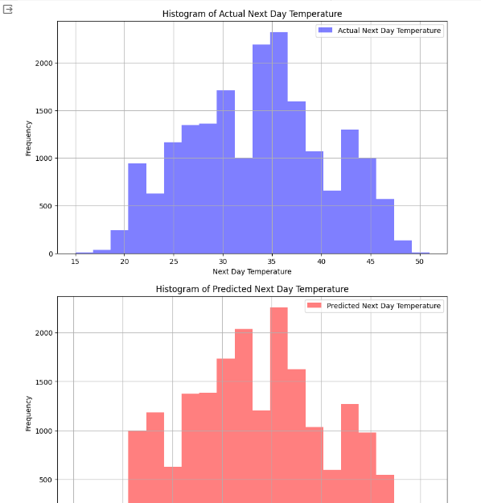
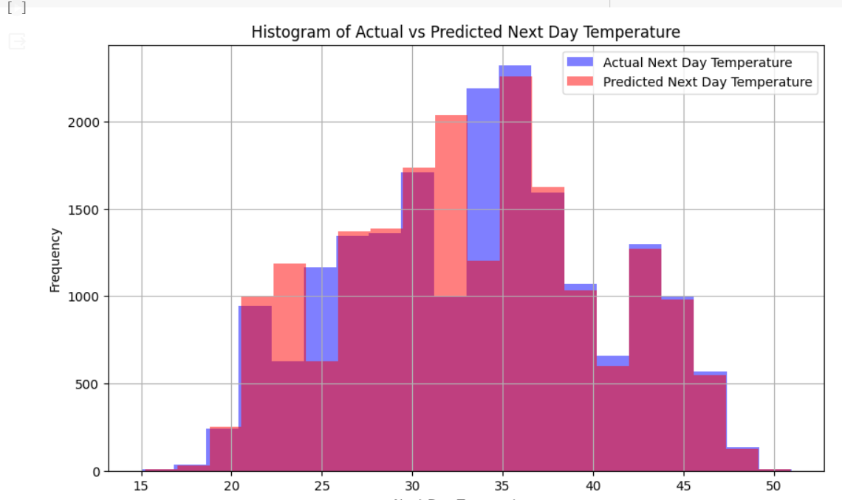
SOLUTION AND ITS VALUE PROPOSITION
ANN PREDICTION
3/21/2024 Annual Review

Slide 14

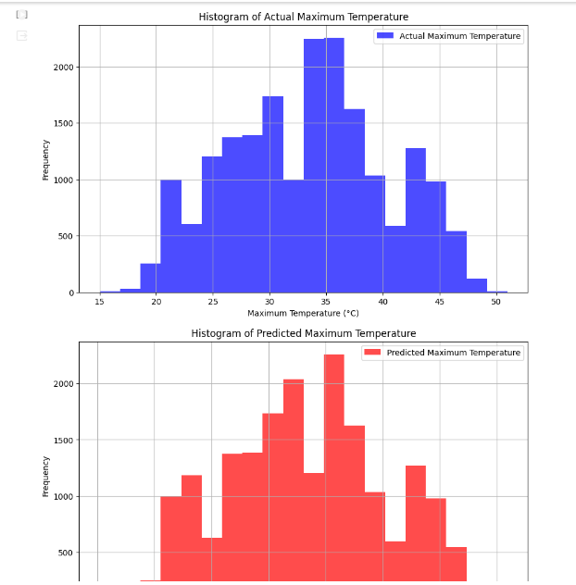
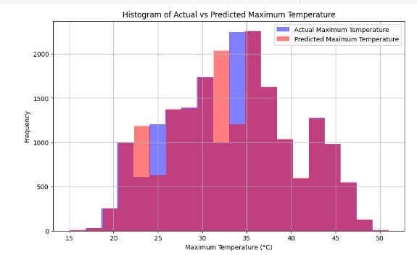
SOLUTION AND ITS VALUE PROPOSITION
RNN USING LSTM

Slide 15

RESULT
The result of the weather forecasting project for Kanpur involves evaluating the accuracy of predicted maximum temperatures generated by Artificial Neural Networks (ANN) and Recurrent Neural Networks (RNN) with Long Short-Term Memory (LSTM). Evaluation metrics like Mean Squared Error (MSE) are used to assess model performance, while visualizations compare predicted temperatures with actual observations. Comparisons with baseline methods highlight the advantages of advanced machine learning techniques. The practical implications for end-users are emphasized, with recommendations for further improvement.
3/21/2024 Annual Review

Slide 16
CONCLUSION
In conclusion, the weather forecasting project for Kanpur successfully leverages advanced machine learning techniques, including Artificial Neural Networks (ANN) and Recurrent Neural Networks (RNN) with Long Short-Term Memory (LSTM), to predict maximum temperatures with accuracy and reliability. Through thorough evaluation using metrics such as Mean Squared Error (MSE) and visualization comparisons with actual observations, the models demonstrate their effectiveness in capturing complex weather patterns. The project underscores the practical significance of accurate weather forecasting for various sectors, including agriculture, transportation, and emergency services, enabling informed decision-making and proactive planning. Moving forward, continued refinement and optimization of the forecasting models hold promise for further enhancing their performance and utility in addressing the dynamic weather conditions of the Kanpur region.
3/21/2024 Annual Review

Slide 17
REFERENCES
https://www.geeksforgeeks.org/artificial-neural-networks-and-its-applications/
https://www.linkedin.com/pulse/predictive-analytics-using-neural-networks-martin-solomon
https://www.geeksforgeeks.org/introduction-to-recurrent-neural-network/
https://encord.com/blog/time-series-predictions-with-recurrent-neural-networks/
Demo Link
3/21/2024 Annual Review

